Slide 1
Packages
In java

Slide 2
Package
It is necessary in software development to create several classes and interfaces.
After creating, it is better if they divided into some groups depending on their relationship.
To handle similar task are put into the same directory and known as PACKAGE.
A package represents a directory that contains related group of classes and interfaces.
Example java.io.*;

Slide 3
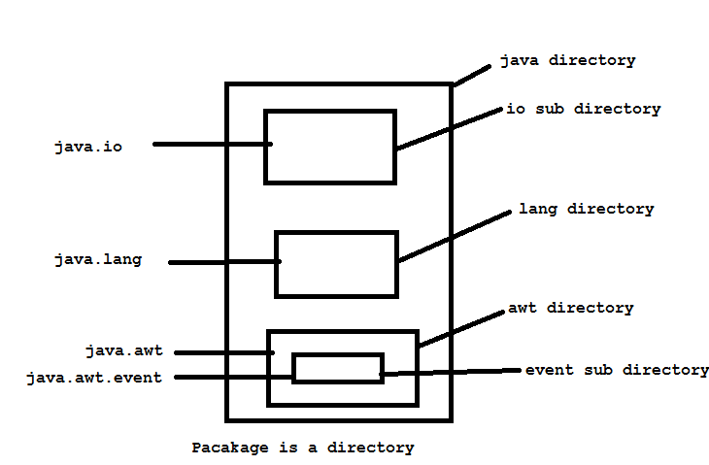
We are importing classes of java.io package. Here java is directory name and io is another sub directory with in it and * represents all classes and interface.

Slide 4
Interview Question
A programmer is writing the following statements in a program:
a)import java.awt.*;
b)import java.awt.event.*;
Should we write both the statements in his program or the first one is enough?
event is a sub package of java.awt package. But, when a package is imported, its sub packages are not automatically imported into a program. So, for every package or sub package, a separate import statements should be written. Hence if the programmer wants the classes and interfaces of both the java.awt and java.awt.event packages, then we should write both the preceding statements in his program.

Slide 5
Advantages of package concept:
Packages are useful to arrange related classess and interfaces into a group. This makes all the classes and interfaces performing the same task to put together in the same package.
For ex: java.io package is a having input and output operations.
Packages hide the classes and interfaces in a separate sub directory, so that accidental deletion of classes and interfaces will not take place.

Slide 6
The classes and interfaces of a package are isolated from the classes and interfaces of another package. This means that we can use same names of classes of two different classes.
For ex Date class is in java.util and also in java.sql package.
A group of packages is called a library. The classes and interfaces of a package are like books in a library and can be reused several times. This reusability nature of packages makes programming easy. Just think, the packages in java created by JavaSoft people only once, and millions of programmers all the world are daily by using them in various programs.

Slide 7
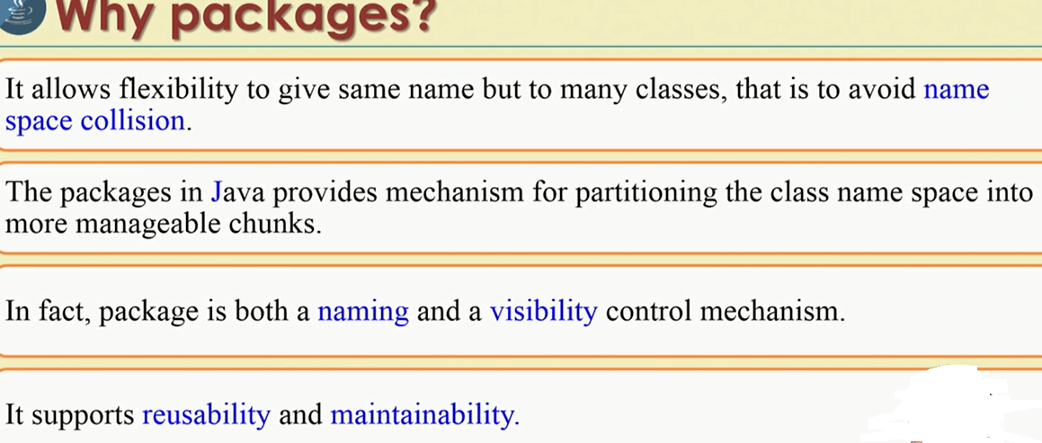

Slide 8
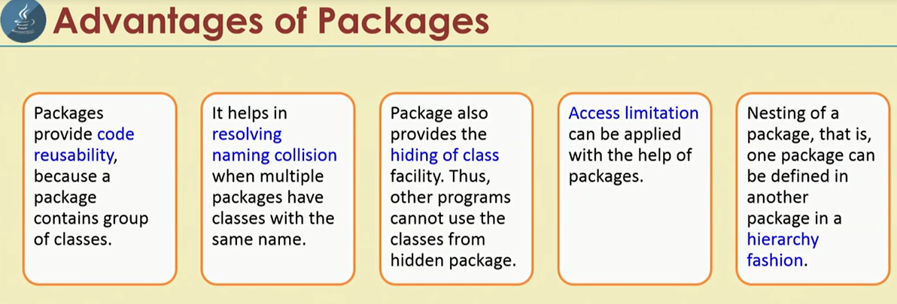

Slide 9
Different types of Packages
Two different types:
Built in packages.
User defined packages.
Built in packages– These packages are already available in java language.
1) java.lang: Contains language support classes(e.g classed which defines primitive data types, math operations). This package is automatically imported. 2) java.io: Contains classed for supporting input / output operations. 3) java.util: Contains utility classes which implement data structures like Linked List, Dictionary and support ; for Date / Time operations. 4) java.applet: Contains classes for creating Applets. 5) java.awt: Contain classes for implementing the components for graphical user interfaces (like button , ;menus etc). 6) java.net: Contain classes for supporting networking operations.

Slide 10
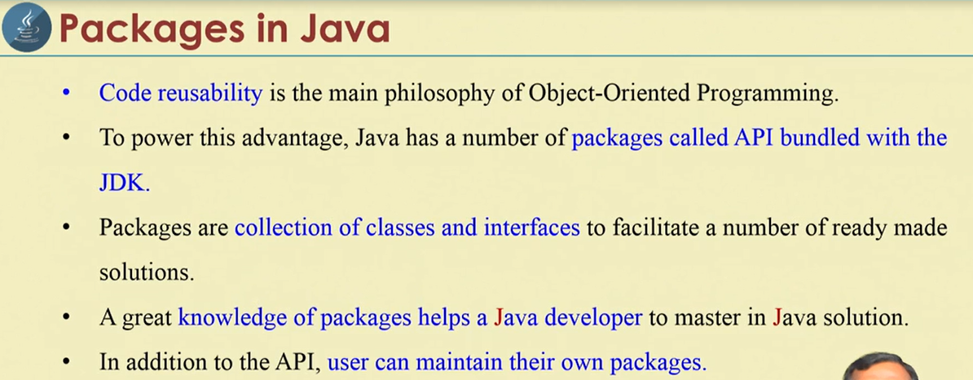

Slide 11
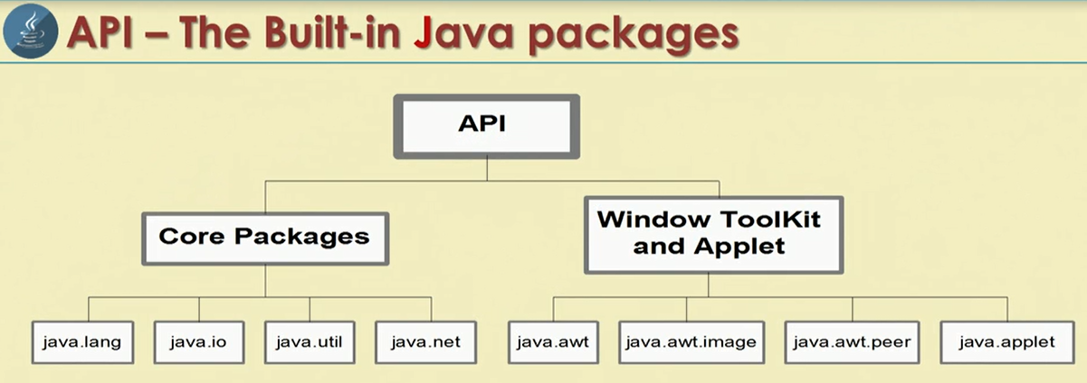

Slide 12
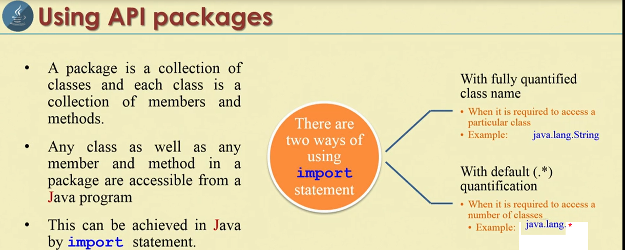

Slide 13
Create package and add class
package pack;
/**
* Addition if variables
*/
public class Addition {
/**
* Instance variables
*/
private double d1,d2;
/**
* parameterized constructor
*/
public Addition(double a , double b)
{
d1=a;
d2=b;
}
/**
* Instance variables
*/
public void sum()
{
System.out.println("Sum ="+(d1+d2));
}
}

Slide 14
In same package
package pack;
public class Use {
public static void main(String[] args) {
// TODO Auto-generated method stub
// create Addition class object
pack.Addition obj = new pack.Addition(10, 15.5);
// call sum method.
obj.sum();
}
}

Slide 15
pack.Addition obj = new pack.Addition(10, 15.5);
Every time we refer with package name before class and this is inconvenient. To over come this we can use import statement at beginning of program.
Import pack.Addition.

Slide 16
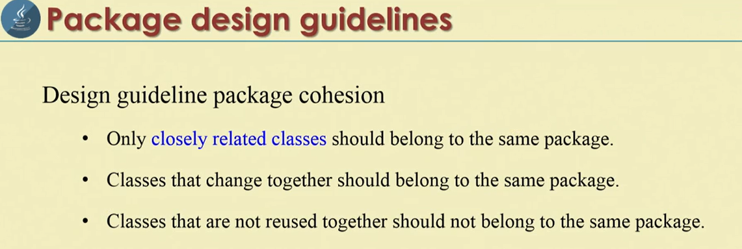

Slide 17
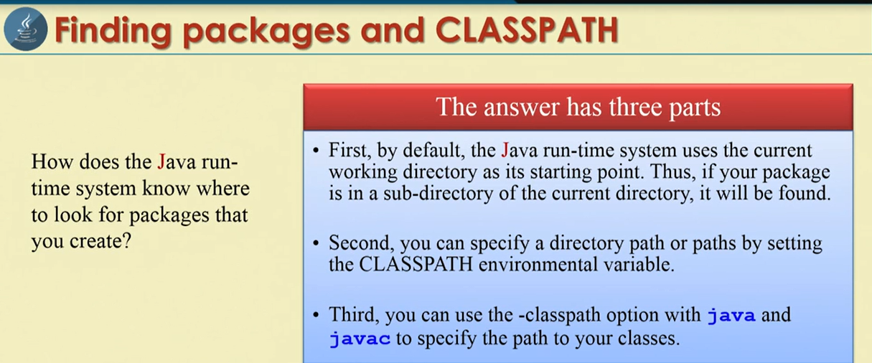

Slide 18
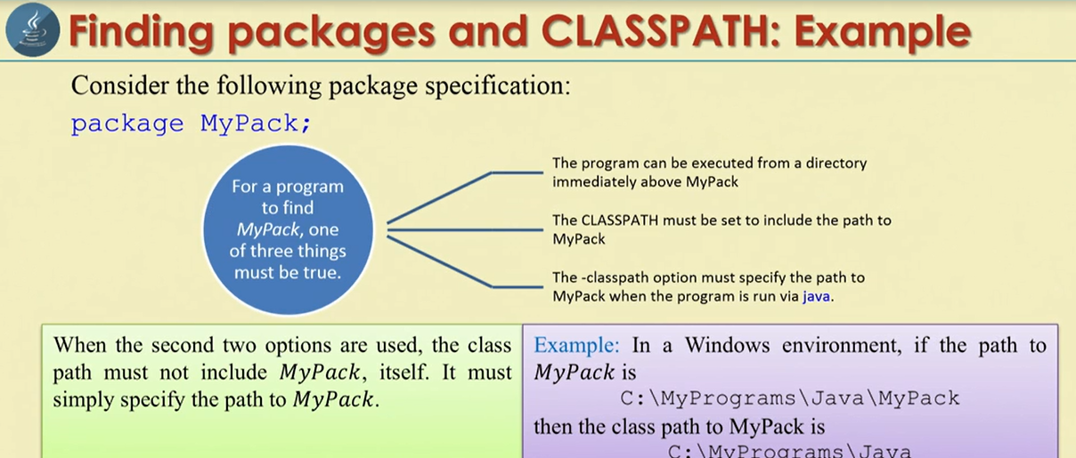

Slide 19
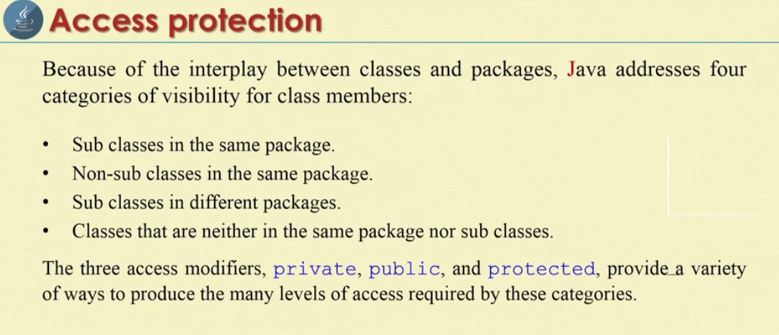

Slide 20
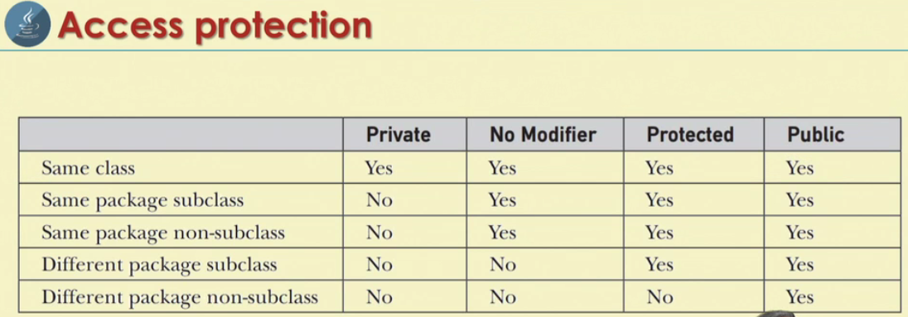

Slide 21
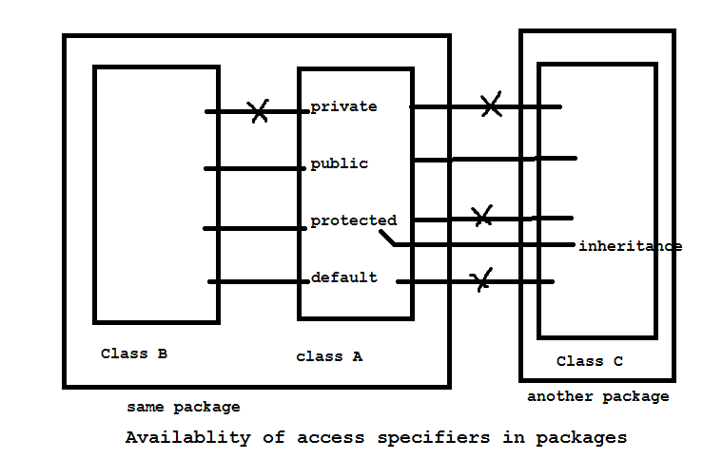
Access specifiers in java

Slide 22
Private member of class A are not available to class B or in class C. Scope is limited to class where it is defined.
So scope of private access specifiers is class scope
Public members of class A is available to class B and c. This means public members are available every where and their scope is global scope.
Protected members of class A are available to class B, but not class C. but if, class C is sub class of class A, then the protected members of class A are available to class C.
So protected access specifier acts as public with respect to sub classes.

Slide 23
When no specifier is mentioned, it is taken as default specifier. Default members of class A are accessible to class B, which is in same package. They are not available to class C. This means the scope of default memebers is Package Scope.
Interview question
What is the scope of default access specifier?
Default members are available with in the same package, but not outside of packages, so their scope is package scope.

Slide 24
Public, private, protected and default.
// class A of same package.
package same;
public class A {
private int a=1;
public int b=2;
protected int c=3;
int d=4; // default
}

Slide 25
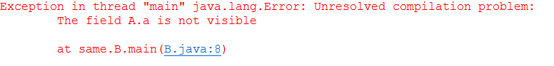
Class B of same package
package same;
// class B of same package
public class B {
public static void main(String[] args) {
// accessing the members of class A
A obj = new A();
//System.out.println(obj.a);
System.out.println(obj.b);
System.out.println(obj.c);
System.out.println(obj.d);
}
}

Slide 26
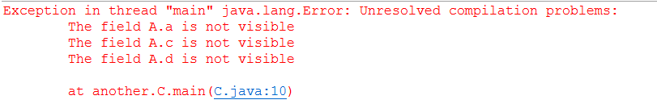
In another package sub class( with out inheritance)
package another;
import same.A;
public class C {
public static void main(String[] args) {
// TODO Auto-generated method stub
A obj = new A();
System.out.println(obj.a);
System.out.println(obj.b);
System.out.println(obj.c);
System.out.println(obj.d);
}
}

Slide 27
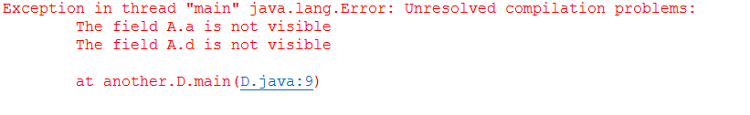
In another package sub class( with inheritance)
package another;
import same.*;
public class D extends A{
public static void main(String[] args) {
// TODO Auto-generated method stub
D obj = new D();
System.out.println(obj.a);
System.out.println(obj.b);
System.out.println(obj.c);
System.out.println(obj.d);
}
}

